Slide 1
Saving our Nation's Bridges
Alison Garrett
Unsolicited Report to the American Society of Civil Engineers
29 October 2021

Slide 2

Introduction
The American Road & Transportation Builders Association reports 171.5 million daily crossings on over 45,000 structurally deficient U.S. bridges
Fortunately, lawmakers are earmarking $3.265B for a 5-year
Bridge Reinvestment Program
While significant, it is likely insufficient to address current and future deficiencies

Slide 3
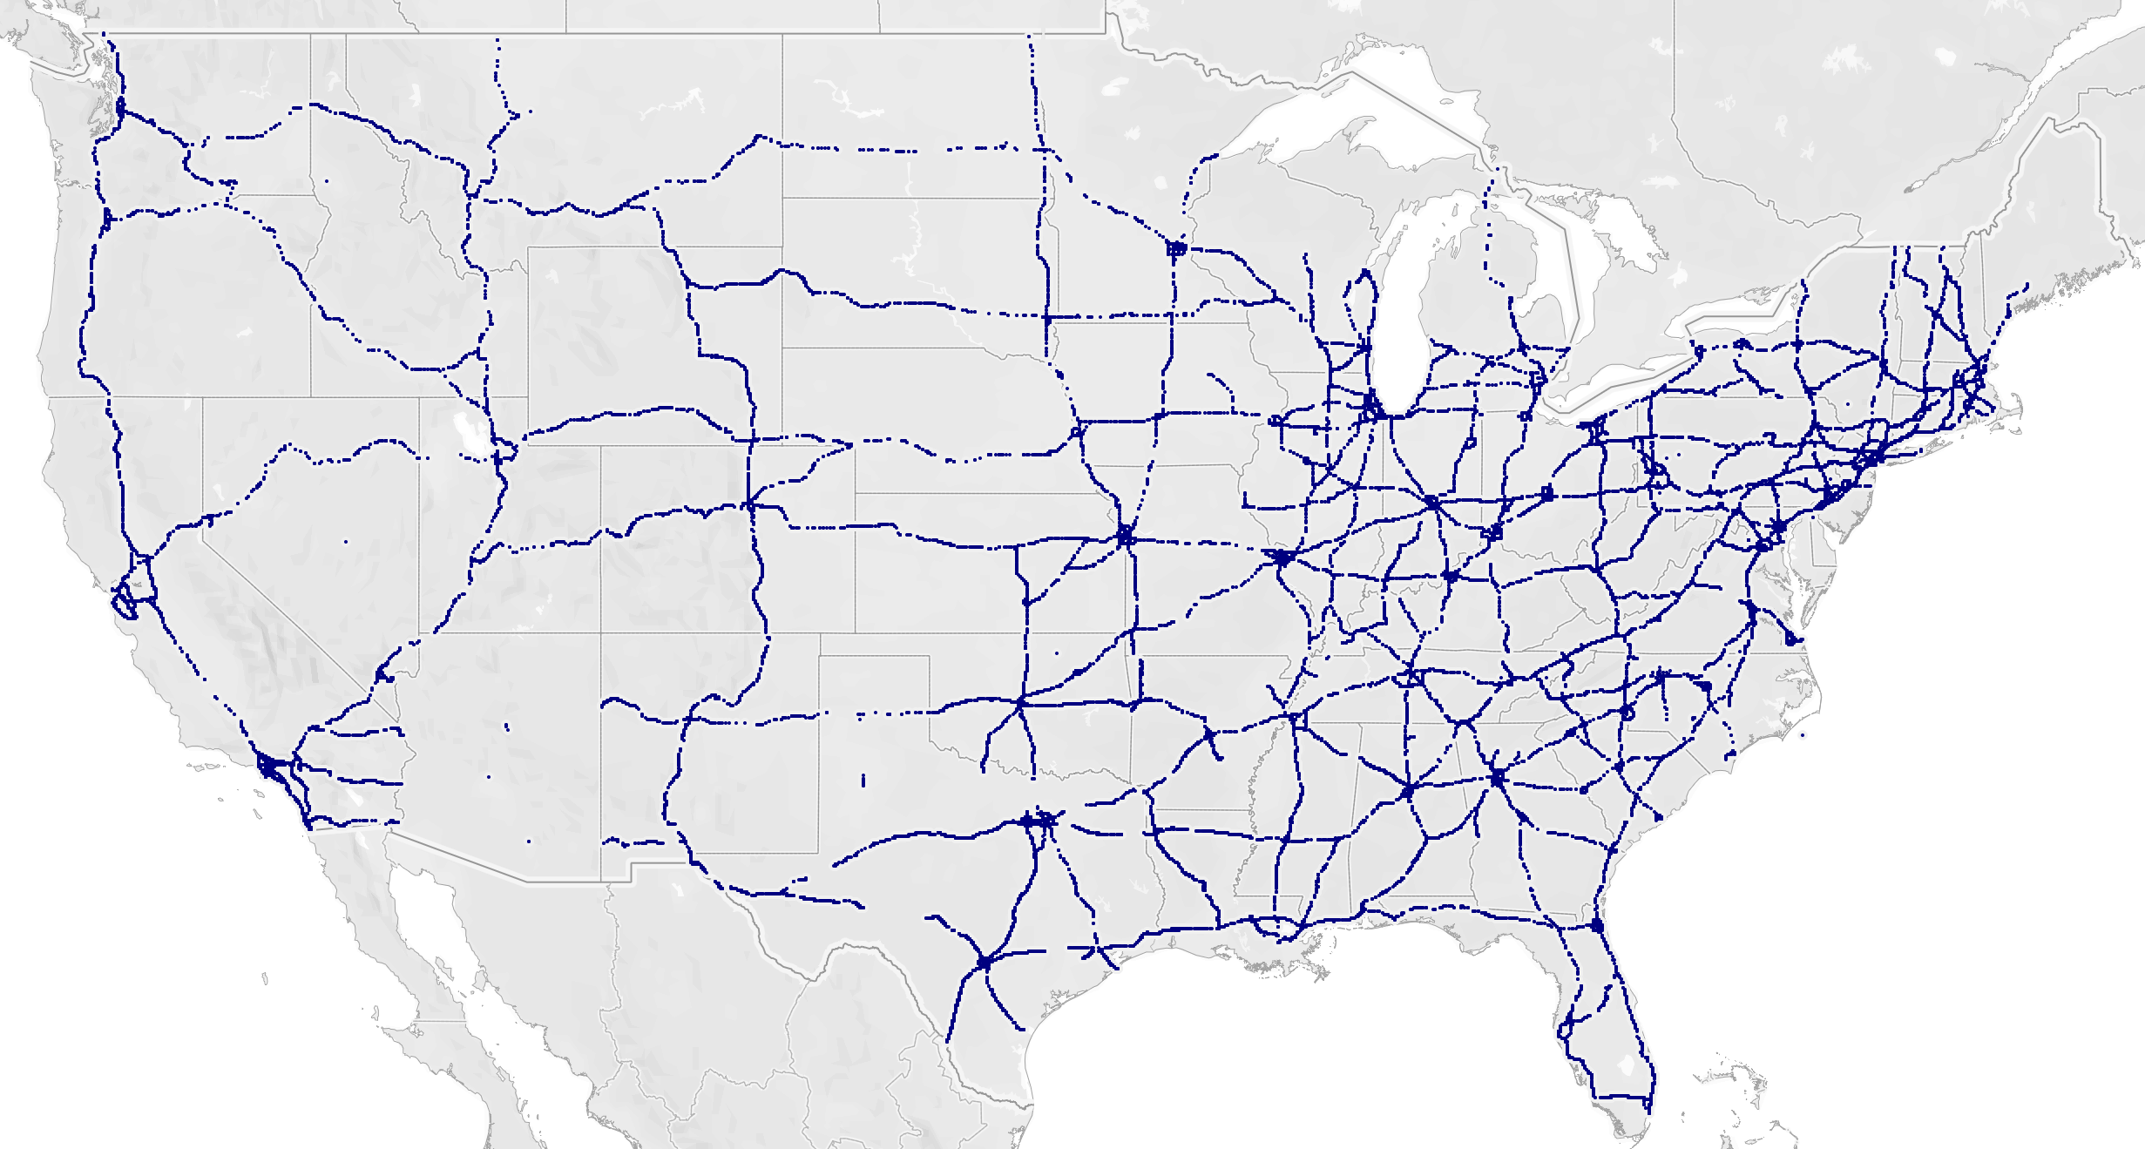
The State of the National Highway System
45,962 National Highway System Bridges in the US

Slide 4
The State of the National Highway System
45,962 NHS Bridges
76% are more than 40 years old
3% (1,363) are classified as Poor - Structurally Deficient and will receive investment
What about the 59% classified as Fair – Needing Repair?

Slide 5
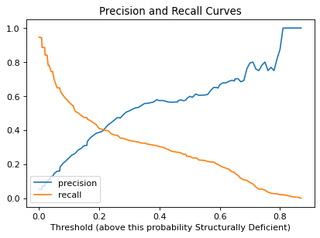
Analysis
Developed an Ensemble Random Forest Classifier to identify Bridge features that are significant when looking at structural deficiency
Focused on high Recall to minimize False Negatives
ROC AUC: 0.875
Threshold: 0.01

Slide 6
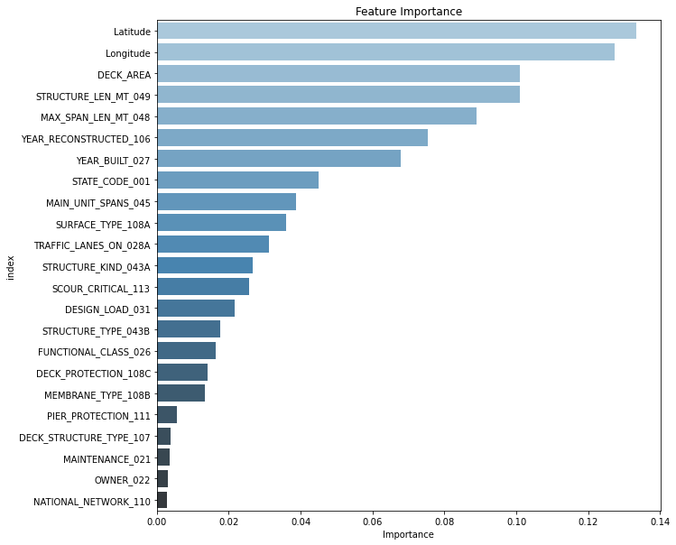
Feature Importance
Location
Dimensions
Age
Type

Slide 7
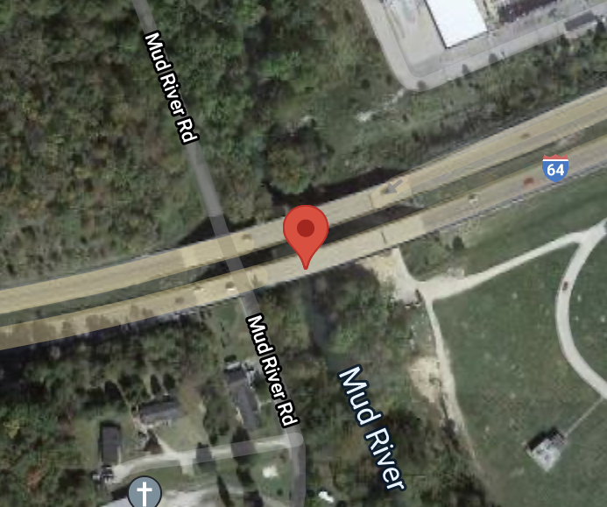
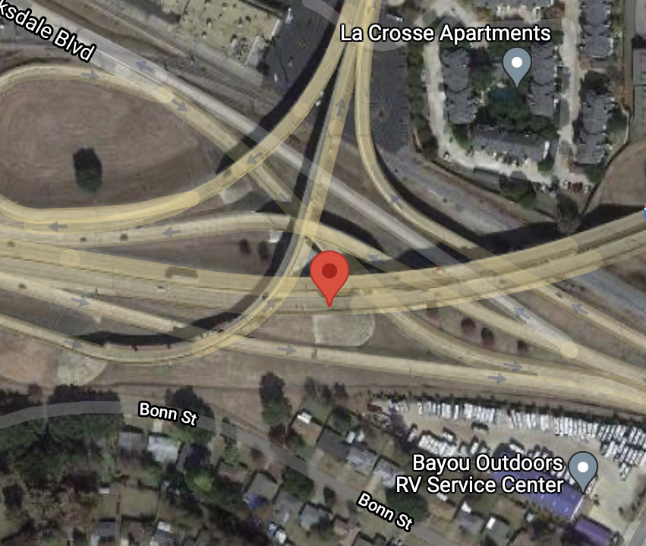
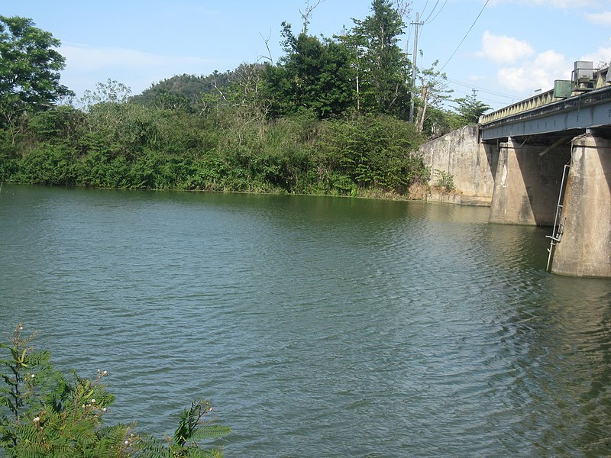
Fair Rated with High Probability Features
I-64 at Mud River Barboursville WV Built: 1959 Daily Traffic: 20,350 Planned Repairs: $31K in 2036 | I-20 at US-71 Bossier City LA Built: 1966 Daily Traffic: 43,950 Planned Repairs: $34K in 2036 | I-15 at Inkom Inkom ID Built: 1962 Daily Traffic: 8,500 Planned Repairs: $13K in 2038 | PR-2 at Guayanilla River Guayanilla PR Built: 1970 Daily Traffic: 37,800 Planned Repairs: $48K in 2025
Photo by Wikimedia Commons / The Eloquent Peasant

Slide 8
Recommendations
Refine the model for improved Precision to better identify and prioritize Bridge Reinvestment Funds following the repair of Structurally Deficient Bridges

